Slide 1

Machine Learning Driven Anemia Identification and Classification System
Guide:Prof. S.G. Dhengre HOD: Dr. S. V. Athawale
Project Coordinators: S. R. Nalamwar, V. V. Navale
ANISH MUKHERJEE 20CO074
TANMAY PARKAR 20CO087
ASHUTOSH SATHE 20CO111
PRATHAMESH PATIL 20CO090

Slide 2
Index
Sr.No | Contents
1. | Introduction
2. | Problem Statement
3. | Motivation
4. | Literature Review
5. | Objective
6. | Feasibility study and scope
7. | Functional and Non-Functional requirements
8. | Risk Analysis
9. | Acceptance Criteria
10. | Architecture
11. | UML Diagrams
12. | Conclusion
13. | Future Scope
14. | References

Slide 3
INTRODUCTION
Machine learning technology is revolutionizing this field by enabling faster and more accurate analysis.
Our aim is to utilize the power of machine learning to provide solution for the faster and cheaper identification and analysis of anemia condition in patients.
We collect and analyse blood sample data using machine learning algorithms to provide timely insights to medical professionals.

Slide 4
PROBLEM STATEMENT
In India, there is a significant anemia challenge, impacting 57% of women (aged 15-49) and 67% of children (6-59 months). The existing method of anemia detection using Complete Blood Count tests is time-consuming, and rural areas suffer from a lack of access to advanced diagnostic equipment. Existing machine learning models either don't eliminate the need of automated machines or classify only one type of anemia.

Slide 5
MOTIVATION
Lack of blood sample test machines in rural and backward areas.
Allow efficient and human-error free results.
To promote health through the use of machine learning and computer engineering techniques.

Slide 6
LITERATURE REVIEW
Paper | Pros | Cons
“Diagnostic Approach To Anemia In Adults Using Machine Learning”, Journal of Pharmaceutical Negative Results, pp. 3713–3717, Dec. 2022, doi: 10.47750/pnr.2022.13.S09.456. | Estimates anaemia accurately and quickly Provides method for cross-checking results | Blood data is input by user Does not remove the need of hematology analyzers.
B. Sen, A. Ganesh, A. Bhan, S. Dixit and A. Goyal, "Machine learning based Diagnosis and Classification Of Sickle Cell Anemia in Human RBC,“ 2021,doi: 10.1109/ICICV50876.2021.9388610. | Uses multiple models, increasing generalization. The models have an average accuracy of 90% | Detects only one type of anemia. Needs more resources to compute results.

Slide 7
LITERATURE REVIEW
Paper | Pros | Cons
Parab, M. A., & Mehendale, N. D. (2021). Red Blood Cell Classification Using Image Processing and CNN. SN Computer Science, 2(2). doi:10.1007/s42979-021-00458-2 | The trained model removes any need for a high-end GPU or processor and can be executed on any low configuration machine The system can identify and classify one normal and 9 abnormal diferent types of RBCs | Not all the RBCs were classified. Features need to be manually extracted.

Slide 8
OBJECTIVE
Study of similar machine learning algorithms used for solving classification and detection problems.
Collection and study of dataset for machine learning model and selection of appropriate datasets.
Design and development of machine learning model using specific dataset
Evaluation of developed model and comparison with existing models.

Slide 9
FEASIBILITY STUDY AND SCOPE
Data Availability
Technical and Medical Expertise
Ethical Considerations
Hardware and Equipment
Data Collection
Model Development
Scalability
Feature Engineering
Interpretability

Slide 10
FUNCTIONAL AND NON-FUNCTIONAL REQUIREMENTS
Functional
User Interface
Login System
Image Upload
Anemia Identification
Anemia Classification
Monitoring and Reporting
Medical Feedback

Slide 11
FUNCTIONAL AND NON-FUNCTIONAL REQUIREMENTS
Non-Functional
Accuracy & Performance
Fairness
Bias
Flexibility
Transparency
Security & Privacy
Testability

Slide 12
STAKEHOLDERS
Healthcare Professionals
Healthcare Institutions and Hospitals
Patients
Community and General Public
Project Sponsor
Data Providers
Project Developers
Regulatory Authorities

Slide 13
Risk Analysis
Data Quality and Availability
Model Accuracy and Generalization
Resource Constraints
Continuous Model Updates
Interpretability Challenges
Hardware and Software Dependencies
Unexpected Patient Conditions

Slide 14
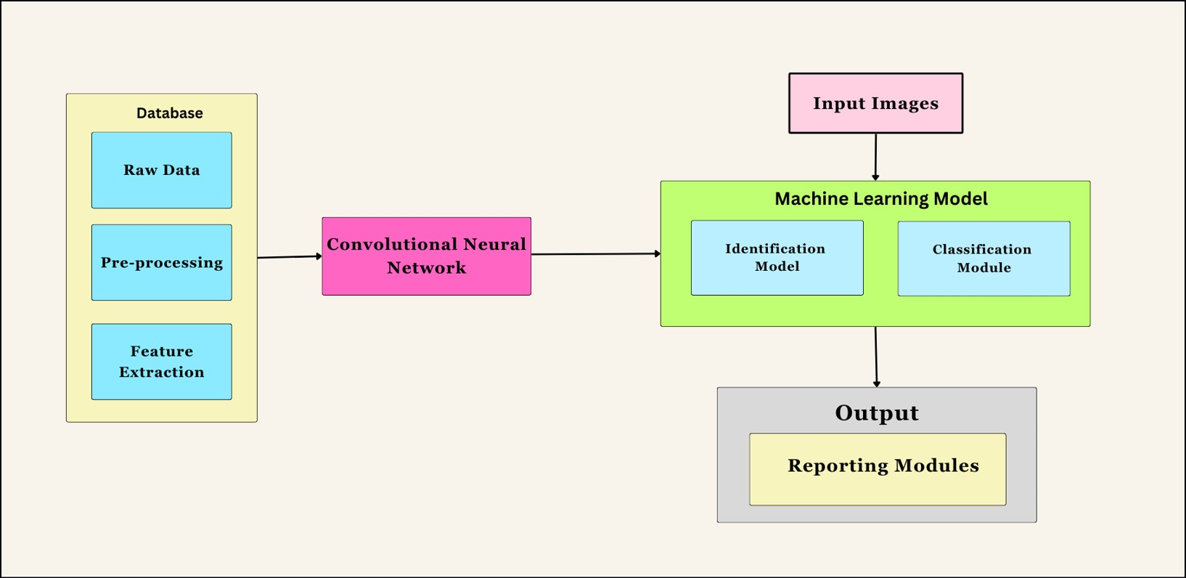
ARCHITECTURE

Slide 15
ARCHITECTURE
Sr. No. | Components | Description
1. | Raw Data | Microscopic blood smear images and annotations taken from local hospital
2. | Pre-Processing | Enhance the quality and suitability of the visual data for subsequent analysis.
3. | Feature Extraction | Strategic selection of relevant features that are indicative of anemia.
4. | Convolutional Neural Network | CNNs are adept at capturing intricate spatial features within images, making them ideal for discerning subtle patterns indicative of anemia in blood cells.
5. | Identification Module | This module will carry out the identification of anemic cells.
6. | Classification Module | This module will classify the anemia type.
7. | Reporting Module | This module will be responsible for reporting the results.

Slide 16
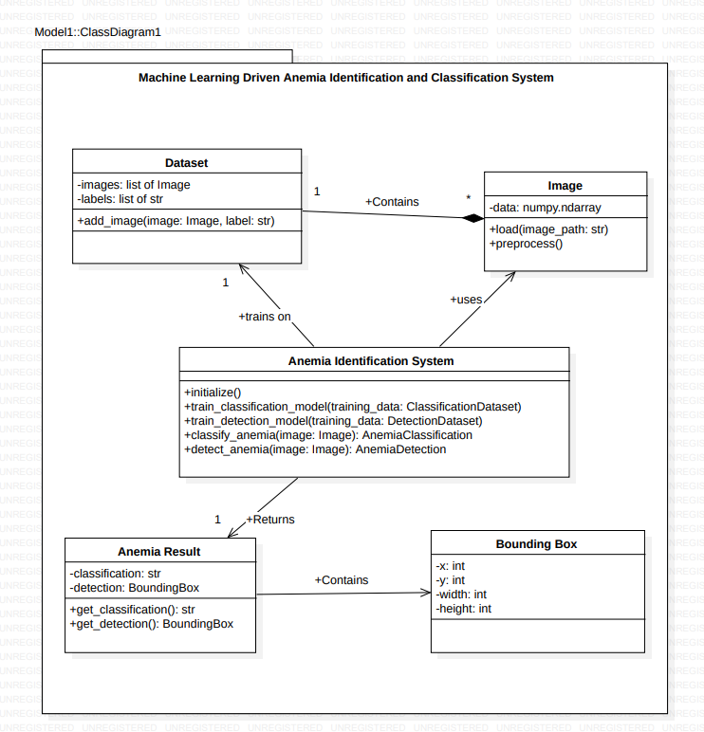
Class Diagram

Slide 17
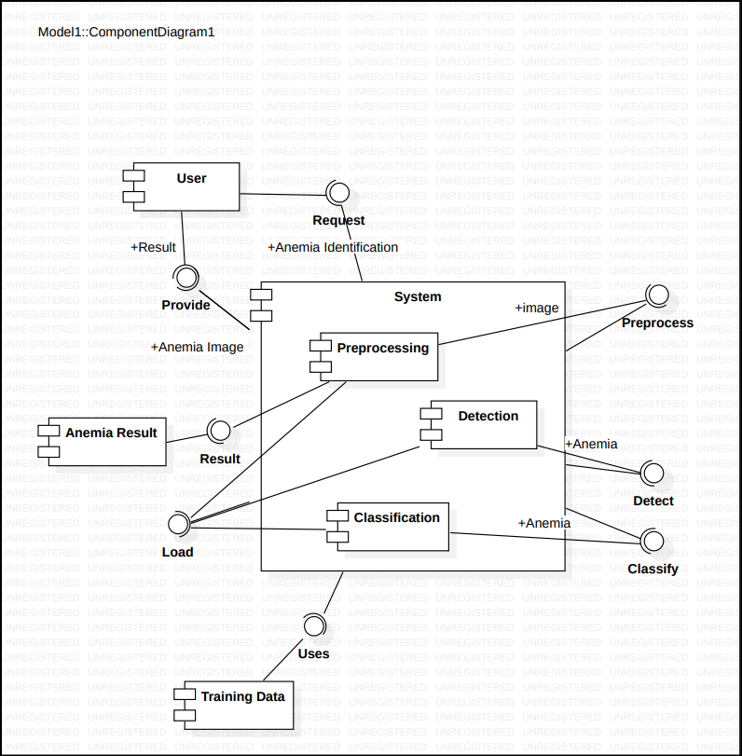
Component Diagram

Slide 18
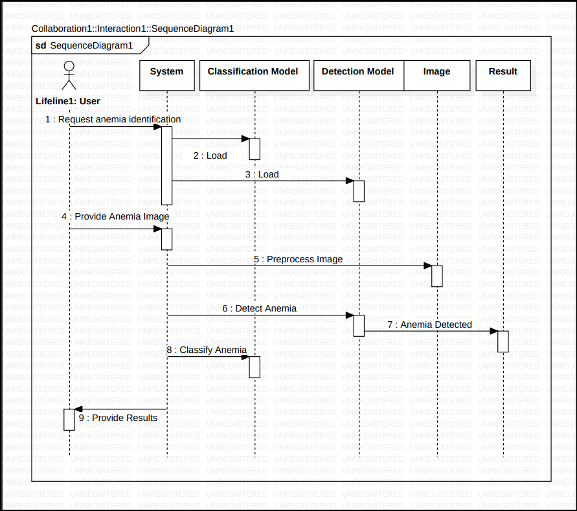
Sequence Diagram

Slide 19
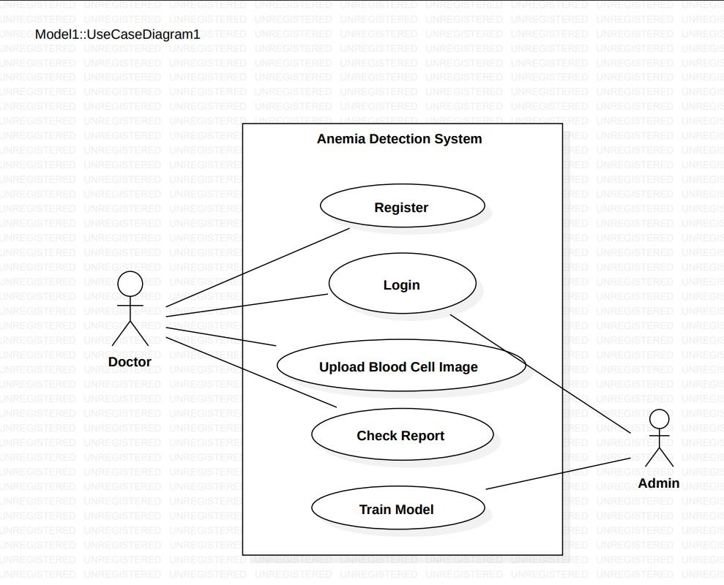
Use-Case Diagram

Slide 20
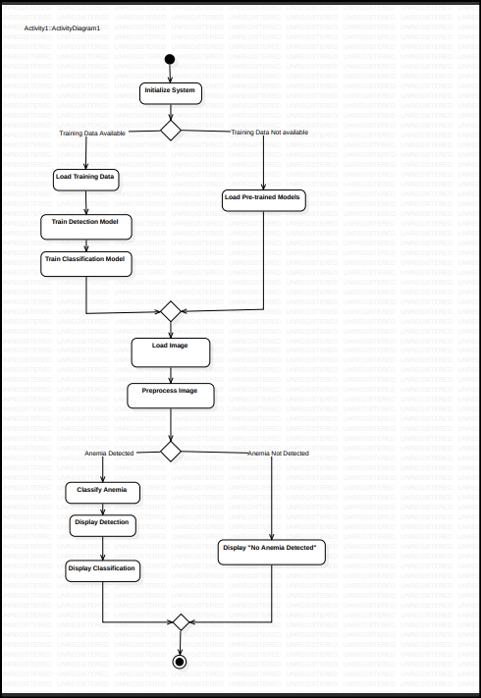
Activity Diagram

Slide 21
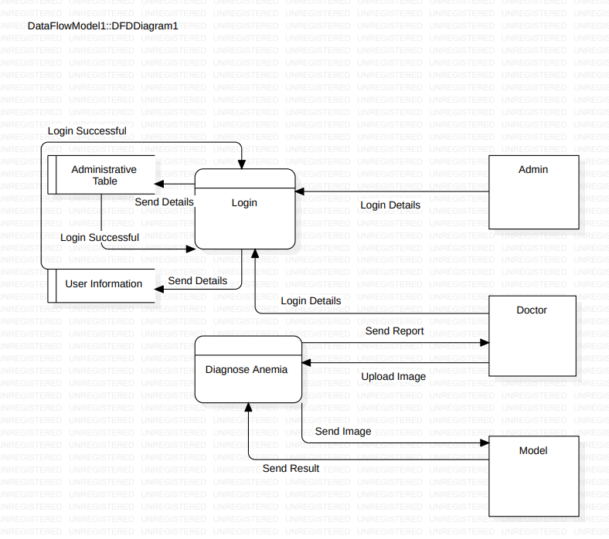
Data Flow Diagram

Slide 22
Conclusion
In summary, this study explores innovative methodologies in anemia detection through cutting-edge technologies like image processing and machine learning. Researchers demonstrate automated solutions, ranging from Raspberry Pi-based systems to convolutional neural networks, for precise recognition of abnormal red blood cells. The utilization of comprehensive datasets, collaborative efforts with healthcare institutions, and the exploration of diverse algorithms enhance the richness of these approaches. Anemia detection via machine learning, employing non-invasive techniques such as multi-wavelength photometry and holographic microscopy, consistently achieves high accuracies, notably with ensemble methods and deep neural networks. Addressing challenges like algorithm bias and ethical considerations, particularly in resource-limited contexts, remains crucial. The integration of emerging technologies like Raspberry Pi underscores the adaptability of machine learning in healthcare. While achievements in accuracy and innovation are evident, future research should prioritize transparency in dataset characteristics and real-world applicability to advance this critical domain of healthcare.

Slide 23
Future Scope
The future scope for this project lies in further refining and expanding the application of advanced technologies in anemia detection. Continued research can focus on enhancing algorithm robustness, addressing biases, and ensuring ethical considerations in diverse healthcare settings. Exploration of novel data sources, integration with emerging technologies, and collaboration with healthcare institutions can advance the project's impact. Additionally, efforts to deploy the developed solutions in real-world scenarios and adapting them to evolving healthcare landscapes will contribute to the sustained relevance and success of the project.

Slide 24
REFERENCES
Parab, M.A., Mehendale, N.D. Red Blood Cell Classification Using Image Processing and CNN. SN COMPUT. SCI. 2, 70 (2021).
P. T. Dalvi and N. Vernekar, "Anemia detection using ensemble learning techniques and statistical models," 2016 IEEE International Conference on Recent Trends in Electronics, Information & Communication Technology (RTEICT), Bangalore, India, 2016, pp. 1747-1751,
S B. Sen, A. Ganesh, A. Bhan, S. Dixit and A. Goyal, "Machine learning based Diagnosis and Classification Of Sickle Cell Anemia in Human RBC," 2021 Third International Conference on Intelligent Communication Technologies and Virtual Mobile Networks (ICICV), Tirunelveli, India, 2021, pp. 753-758.
Jaiswal, M., Srivastava, A., Siddiqui, T.J. (2019). Machine Learning Algorithms for Anemia Disease Prediction. In: Khare, A., Tiwary, U., Sethi, I., Singh, N. (eds) Recent Trends in Communication, Computing, and Electronics. Lecture Notes in Electrical Engineering, vol 524. Springer, Singapore.
An R, Huang Y, Man Y, Valentine RW, Kucukal E, Goreke U, Sekyonda Z, Piccone C, Owusu-Ansah A, Ahuja S, Little JA, Gurkan UA. Emerging point-of-care technologies for anemia detection. Lab Chip. 2021 May 18;21(10):1843-1865.
R. V. Pellegrino, A. C. Tarrobago and D. L. B. Zulueta, "Development of Anemia Cells Recognition System Using Raspberry Pi," 2023 15th International Conference on Computer and Automation Engineering (ICCAE), Sydney, Australia, 2023, pp. 198-203,
Shahzad, Muhammad, Arif Iqbal Umar, Syed Hamad Shirazi, Zakir Khan, Asfandyar Khan, Muhammad Assam, Abdullah Mohamed, and El-Awady Attia. 2022. "Identification of Anemia and Its Severity Level in a Peripheral Blood Smear Using 3-Tier Deep Neural Network" Applied Sciences 12, no. 10: 5030.
Rizal, A.S. et al. (2022) ‘Detecting anemia based on palm images using convolutional neural network’, International Journal of Advanced Engineering Research and Science, 9(9), pp. 280–287.
Zhang A, Lou J, Pan Z, Luo J, Zhang X, Zhang H, Li J, Wang L, Cui X, Ji B, Chen L. Prediction of anemia using facial images and deep learning technology in the emergency department. Front Public Health. 2022 Nov 9;10:964385. PMCID: PMC9682145.
Nithya, R & Nirmala, K. (2022). Detection of Anaemia using Image Processing Techniques from microscopy blood smear images. Journal of Physics: Conference Series.
A. Kovačević, A. Lakota, L. Kuka, E. Bečić, A. Smajović and L. G. Pokvić, "Application of Artificial Intelligence in Diagnosis and Classification of Anemia," 2022 11th Mediterranean Conference on Embedded Computing (MECO), Budva, Montenegro, 2022, pp. 1-4, .
Justice Williams Asare, PETER APPIAHENE, Emmanuel Timmy Donkoh, et al. Iron Deficiency Anemia Detection using Machine Learning Models: A Comparative Study of Fingernails, Palm and Conjunctiva of the Eye Images. Authorea. February 06, 2023

Slide 25
THANK YOU

